Slide 1

Predictive Learning from Data
LECTURE SET 7
Methods for Regression
Electrical and Computer Engineering

Slide 2
OUTLINE of Set 7
Objectives
- introduce taxonomy of methods for regression;
- describe several representative nonlinear methods;
- empirical comparisons illustrating advantages and limitations of these methods
Methods’ taxonomy
Linear methods
Adaptive dictionary methods
Kernel methods and local risk minimization
Empirical comparisons
Combining methods
Summary and discussion

Slide 3
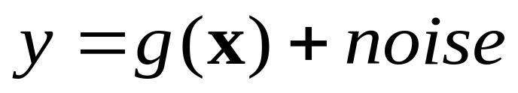
Motivation and issues
Importance of regression for implementation of
- classification
- density estimation
Estimation of a real-valued function when data (x,y) is generated as
Issues for regression
- parameterization (representation) for f(x,w)
- optimization formulation (~ empirical loss)
- complexity control (model selection)
These issues are inter-related
Why there are so many learning methods?

Slide 4
Loss function and noise model
Fundamental problem: how to distinguish between true signal and noise?
Classical statistical view
- noise density p(noise) is known
→ statistically “optimal” loss function in the maximum likelihood sense is
→ for Gaussian noise use squared loss (MSE) as empirical loss function

Slide 5
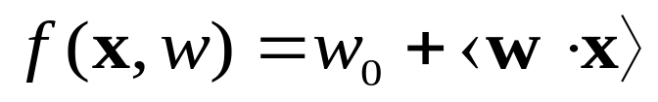
Loss functions for linear regression
Consider linear regression only
Several unimodal noise models:
- Gaussian, Laplacian, unimodal
Statistical view:
- Optimal loss for known noise density
- asymptotic setting
- robust strategies when noise model unknown
Practical situations
- noise model is unknown
- finite (sparse) sample setting

Slide 6
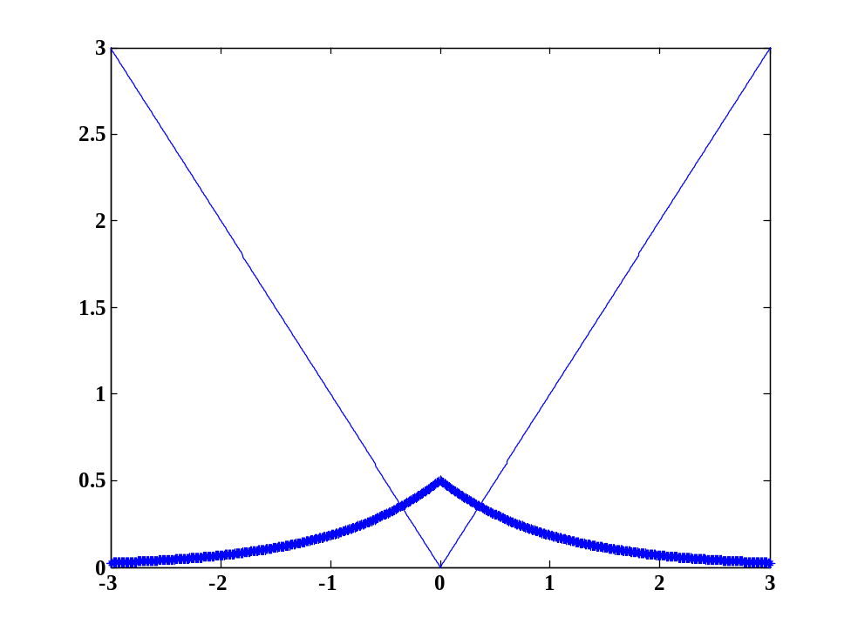
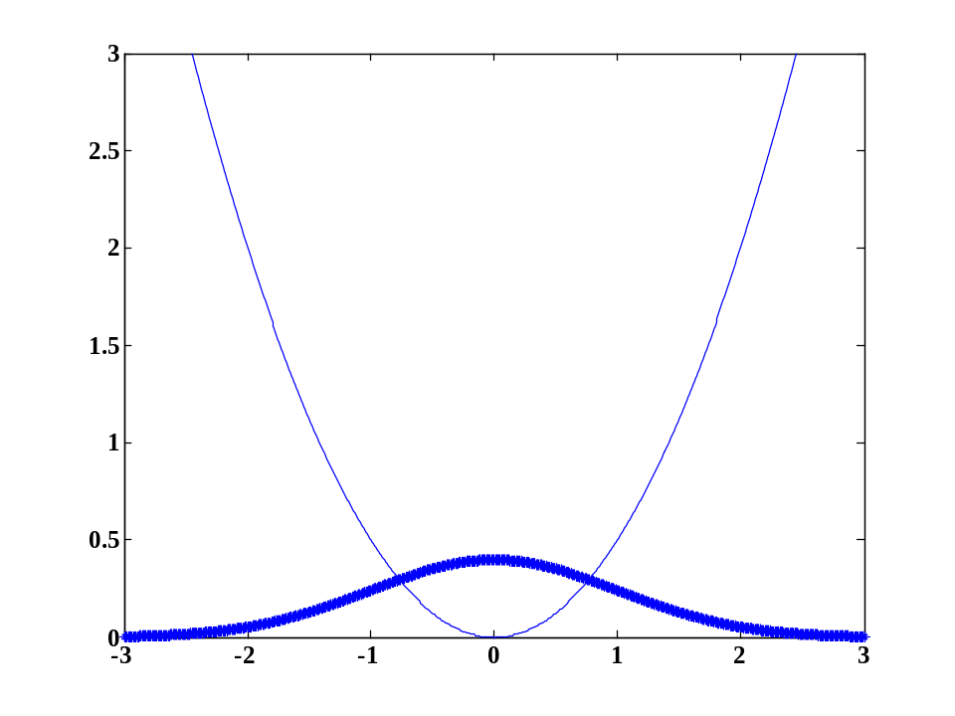
(a)Linear loss for Laplacian noise (b)Squared loss for Gaussian noise

Slide 7

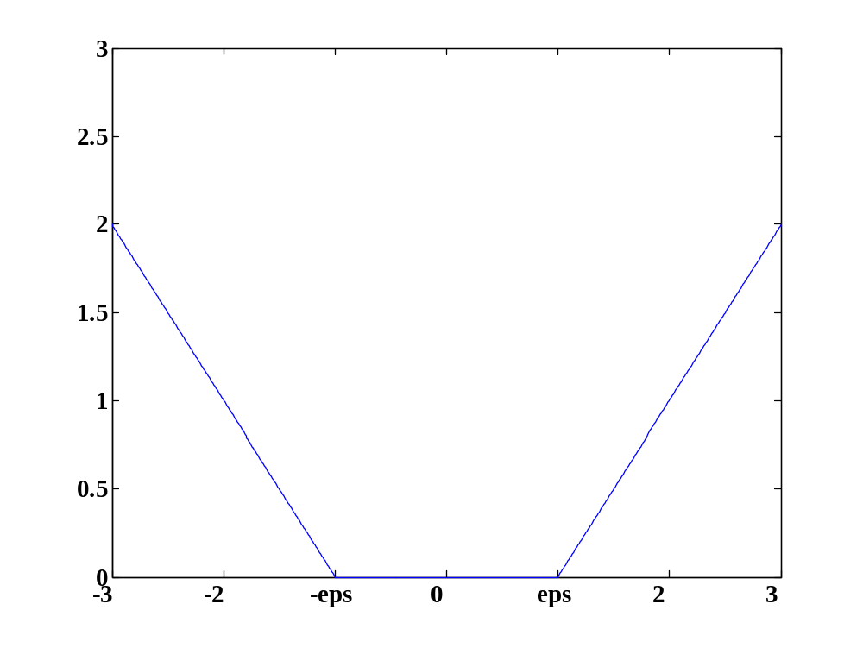
-insensitive loss (SVM) has common-sense interpretation.
Optimal epsilon depends on noise level and sample size

Slide 8
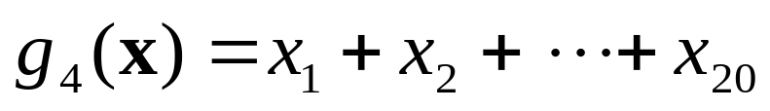
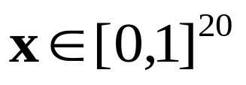
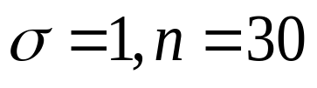
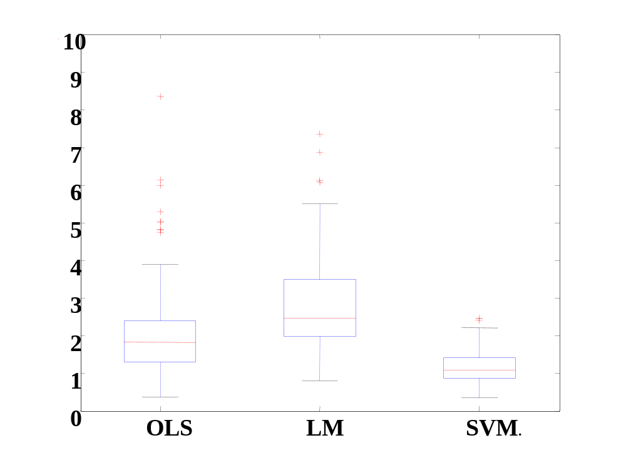
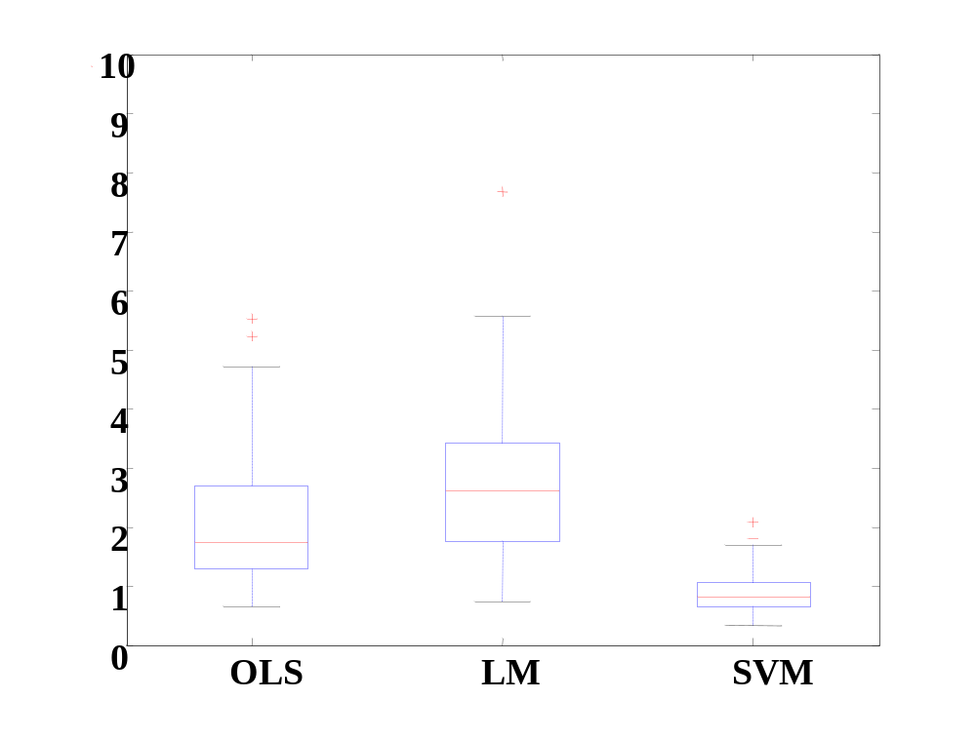
Comparison for high-dimensional data:
Gaussian noise Laplacian noise

Slide 9
Methods’ Taxonomy
Recall implementation of SRM:
- fix complexity (VC-dimension)
- minimize empirical risk (squared-loss)
Two interrelated issues:
- parameterization (of possible models)
- optimization method (~ empirical loss fct)
Taxonomy will be based on
parameterization: dictionary vs kernel
flexibility: non-adaptive vs adaptive

Slide 10
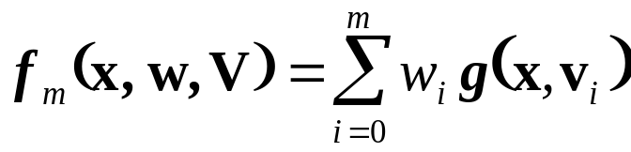
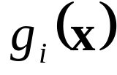

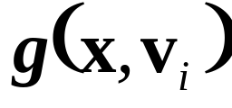

Dictionary representation
Two possibilities
Linear (non-adaptive) methods
~ predetermined (fixed) basis functions
→ only parameters have to be estimated
via standard optimization methods (linear least squares)
Examples: linear regression, polynomial regression
linear classifiers, quadratic classifiers
Nonlinear (adaptive) methods
~ basis functions depend on the training data
Possibilities : nonlinear b.f. (in parameters ), i.e. MLP,
feature selection, projection pursuit etc.

Slide 11
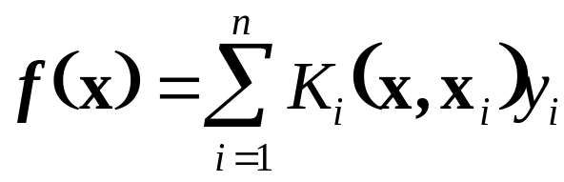



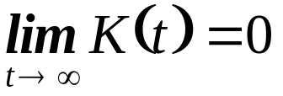
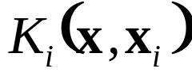
Kernel Methods
Model estimated as
where symmetric kernel function is
- non-negative
- radially symmetric
- monotonically decreasing with
Duality between dictionary and kernel representation:
model ~ weighted combination of basis functions
model ~ weighted combination of output values
Selection of kernel functions
non-adaptive ~ depends only on x-values
adaptive ~ depends on y-values of training data
Note: kernel methods may require local complexity control

Slide 12
OUTLINE
Objectives
Methods taxonomy
Linear methods
Estimation of linear models
Equivalent representations
Non-adaptive methods
Application Example
Adaptive dictionary methods
Kernel methods and local risk minimization
Empirical comparisons
Combining methods
Summary and discussion

Slide 13
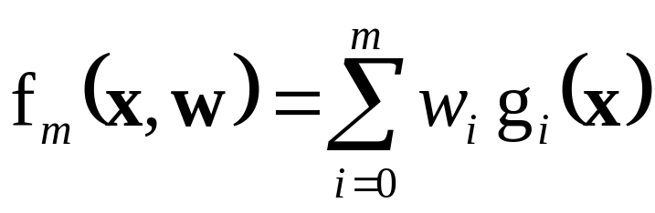
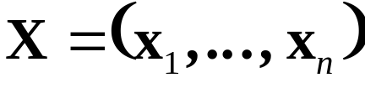
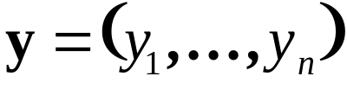
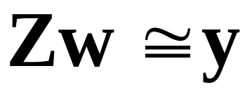
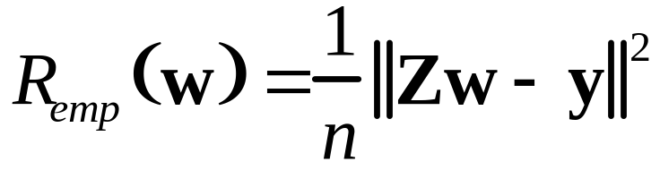
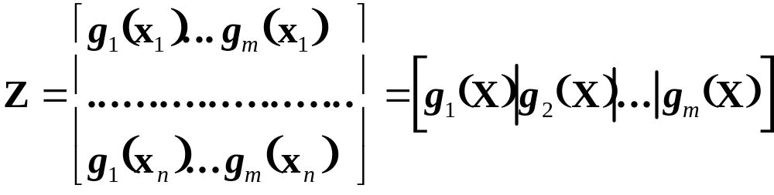
Estimation of Linear Models
Dictionary representation
Parameters w estimated via least-squares
Denote training data as matrix
and vector of response values
OLS solution ~ solving matrix equation
where

Slide 14
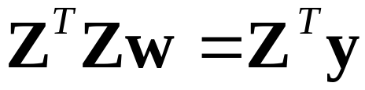
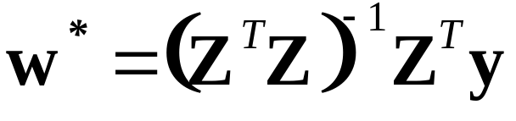
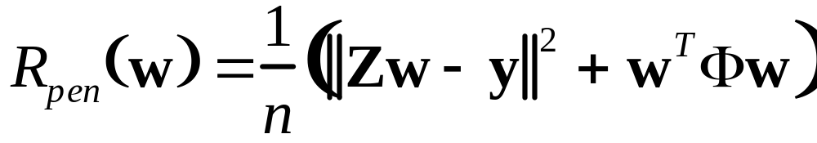
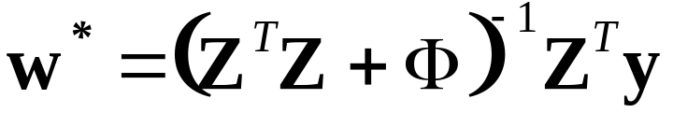
Estimation of Linear Models (cont’d)
Solution exists if the columns of Z are linearly independent (m < n)
Solving the normal equation
yields OLS solution
Similar math holds for penalized OLS where
OLS solution

Slide 15
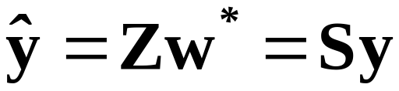
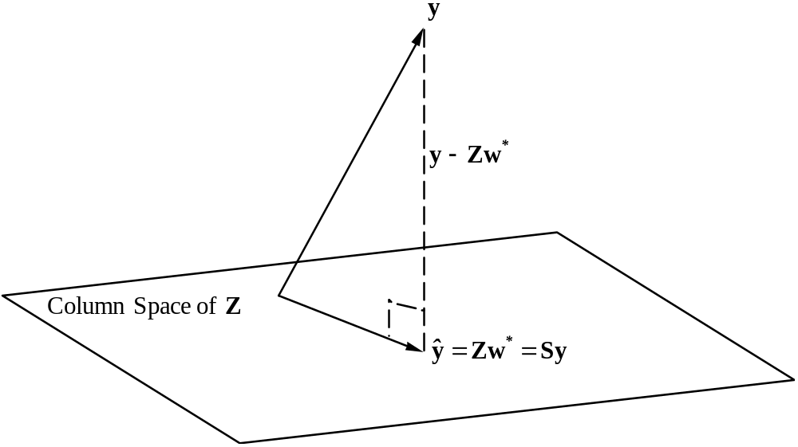
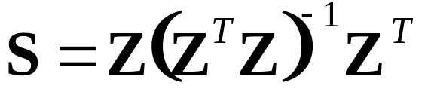
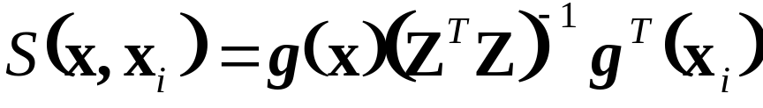
Equivalent Representations
For dictionary representation
OLS solution is
nXn matrix S ~projection matrix
Matrix S ~ ‘equivalent’ kernel of an OLS model with w*

Slide 16
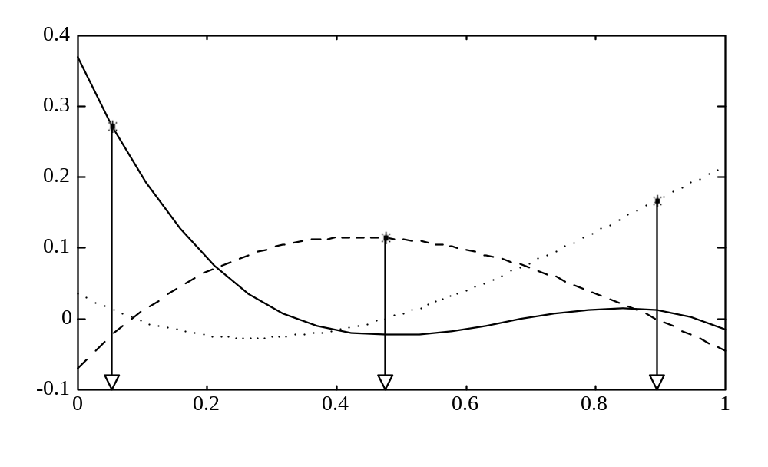
Equivalent Representation (cont’d)
Equivalent kernel
may not be local
Equivalent ‘kernels’ of a 3-rd degree polynomial

Slide 17
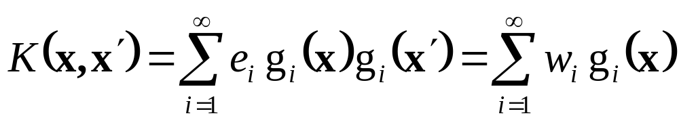
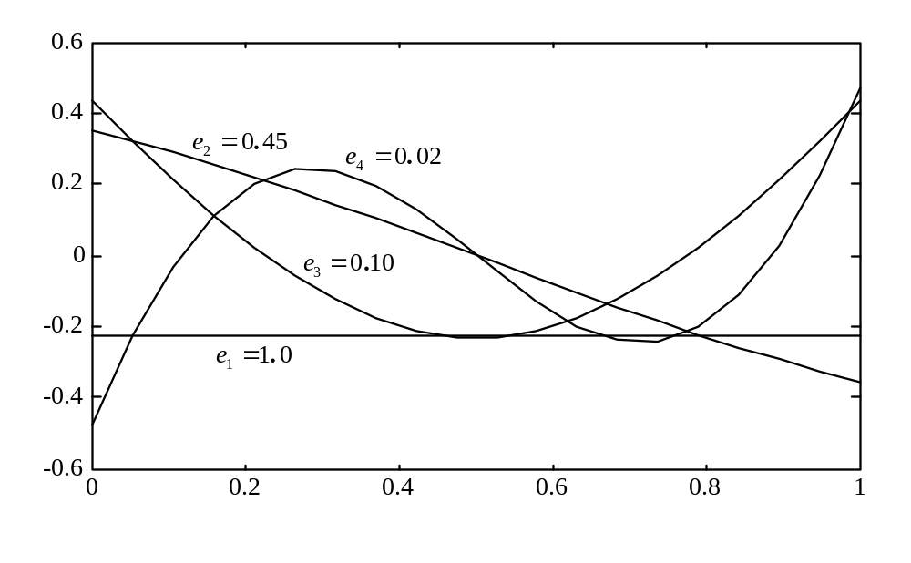
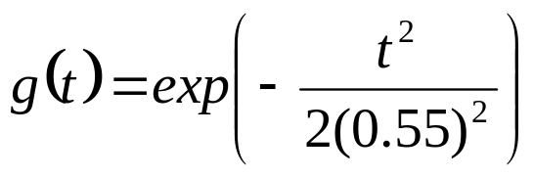
Equivalent BFs for Symmetric K(x, x’)
Eigenfunction decomposition of a kernel
The eigenvalues tend to fall off rapidly with i
4 BF’s for kernel

Slide 18
Equivalent Representations: summary
Equivalence of representations is due to duality of OLS solution
Equivalent ‘kernels’ are just math artifacts (may be non-local). Notational distinction: K vs S
Practical use of matrix S for:
- analytic form of LOO cross-validation
- estimating model complexity for penalized linear estimators (~ ridge regression)

Slide 19
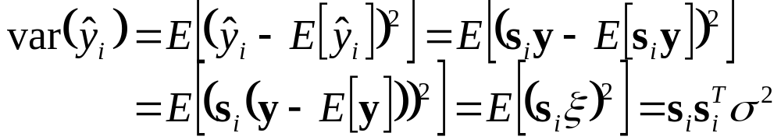
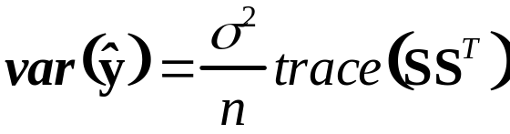

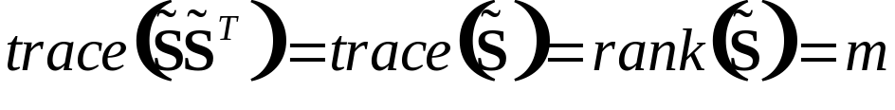
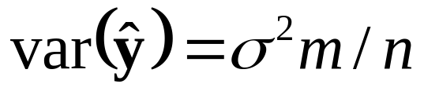

Estimating Complexity
Linear estimator is specified via matrix S. Its complexity ~ the number of parameters m of an equivalent linear estimator
→ ave variance of the training data
Consider an equivalent linear estimator with matrix where is symmetric of rank m :
so the average variance is
effective DoF of estimator with matrix S is
Note: effective DoF does not equal VC-dim (Section 7.2.3)

Slide 20
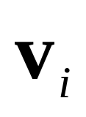
Non-adaptive methods
Dictionary representation
basis functions depend only on x-values
Representative methods include:
- local polynomials (splines) from statistics
where parameters are knot locations
- RBF networks from neural networks
where parameters are RBF center and width
Only non-adaptive implementation of RBF will be considered here

Slide 21
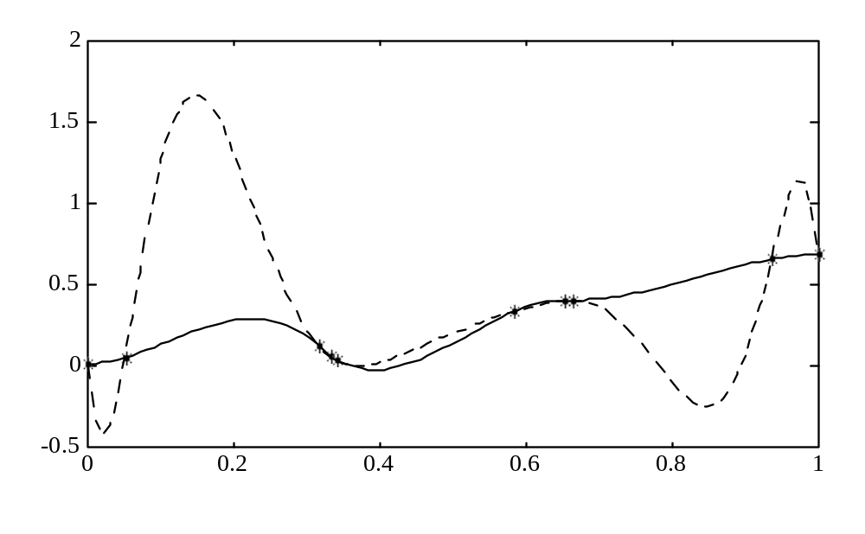
Local polynomials and splines
Motivation: data interpolation(univariate regression)
problem with polynomials → local low-order polynomials
knot location strategies: subset of training samples, or uniformly spaced in x-domain.

Slide 22
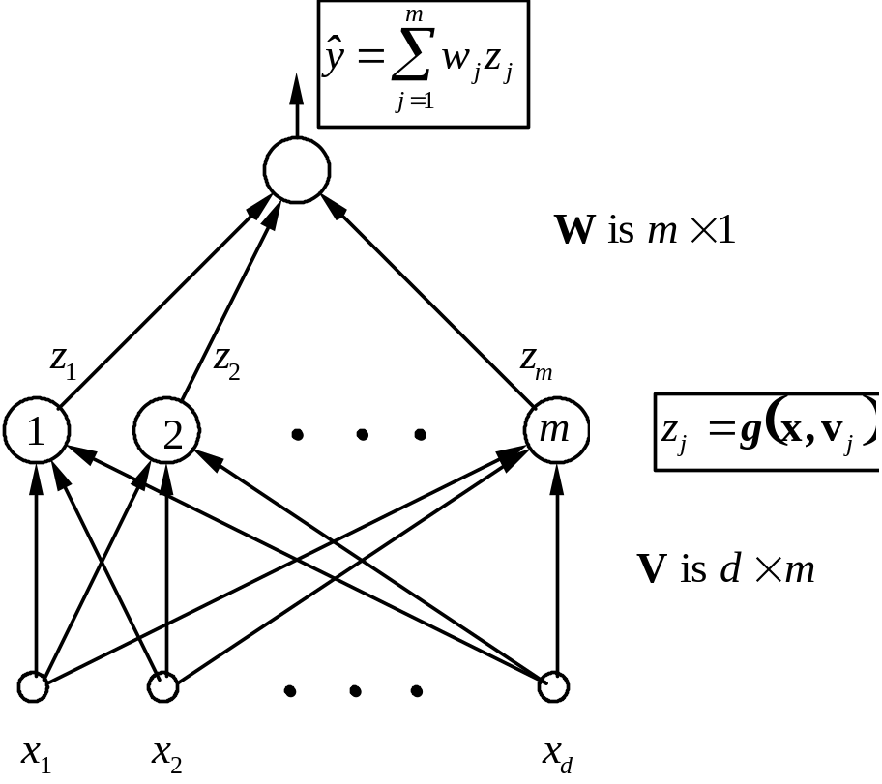
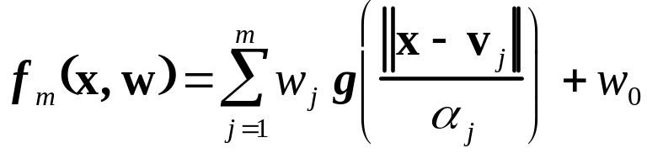
RBF Networks for Regression
RBF networks
typically local BFs
Training ~ estimating
-parameters of BF’s
-linear weights W
- non-adaptive implementation (TBD next)
- adaptive implementation
RBF networks require pre-scaling of inputs

Slide 23


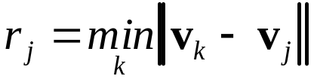




Non-adaptive RBF training algorithm
Choose the number of basis functions (centers) m.
Estimate centers using x-values of training data via unsupervised training (SOM, GLA, clustering etc.)
Determine width parameters using heuristic:
For a given center
(a) find the distance to the closest center:
for all
(b) set the width parameter
where parameter controls degree of overlap between adjacent basis functions. Typically
4. Estimate weights w via linear least squares (minimization of the empirical risk).

Slide 24
Application Example: Predicting NAV of Domestic Mutual Funds
Motivation
Background on mutual funds
Problem specification + experimental setup
Modeling results
Discussion

Slide 25
Background: pricing mutual funds
Mutual funds trivia
Mutual fund pricing:
- priced once a day (after market close)
→ NAV unknown when an order is placed
How to estimate NAV accurately?
Approach 1: Estimate holdings of a fund (~200-400 stocks), then find NAV
Approach 2: Estimate NAV via correlations btwn NAV and major market indices (learning)

Slide 26
Problem specs and experimental setup
Domestic fund: Fidelity OTC (FOCPX)
Possible Inputs:
SP500, DJIA, NASDAQ, ENERGY SPDR
Data Encoding:
Output ~ % daily price change in NAV
Inputs ~ % daily price changes of market indices
Modeling period: 2003.
Issues: modeling method? Selection of input variables? Experimental setup?

Slide 27
Experimental Design and Modeling Setup
Possible variable selection:
Mutual Funds | Input Variables
Y | X1 | X2 | X3
FOCPX | ^IXIC | - | -
FOCPX | ^GSPC | ^IXIC | -
FOCPX | ^GSPC | ^IXIC | XLE
All variables represent % daily price changes.
Modeling method: linear regression
Data obtained from Yahoo Finance.
Time period for modeling 2003.

Slide 28
Specification of Training and Test Data
Year 2003
1, 2
3, 4
5, 6
7, 8
9, 10
11, 12
Training Test
Training Test
Training Test
Training Test
Training Test
Two-Month Training/ Test Set-up
→ Total 6 regression models for 2003

Slide 29
Results for Fidelity OTC Fund (GSPC+IXIC)
Coefficients | w0 | w1 (^GSPC) | W2(^IXIC)
Average | -0.027 | 0.173 | 0.771
Standard Deviation (SD) | 0.043 | 0.150 | 0.165
Average model: Y =-0.027+0.173^GSPC+0.771^IXIC
^IXIC is the main factor affecting FOCPX’s daily price change
Prediction error: MSE (GSPC+IXIC) = 5.95%

Slide 30
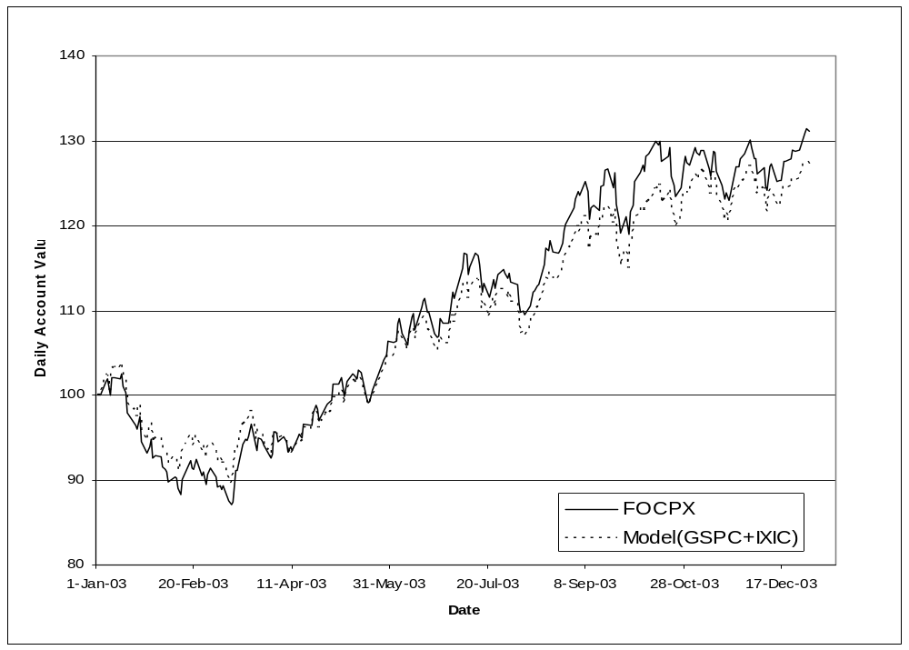
Results for Fidelity OTC Fund (GSPC+IXIC)
Daily closing prices for 2003: NAV vs synthetic model

Slide 31
Results for Fidelity OTC Fund (GSPC+IXIC+XLE)
Coefficients | w0 | w1 (^GSPC) | W2(^IXIC) | W3(XLE)
Average | -0.029 | 0.147 | 0.784 | 0.029
Standard Deviation (SD) | 0.044 | 0.215 | 0.191 | 0.061
Average Model: Y=-0.029+0.147^GSPC+0.784^IXIC+0.029XLE
^IXIC is the main factor affecting FOCPX daily price change
Prediction error: MSE (GSPC+IXIC+XLE) = 6.14%

Slide 32
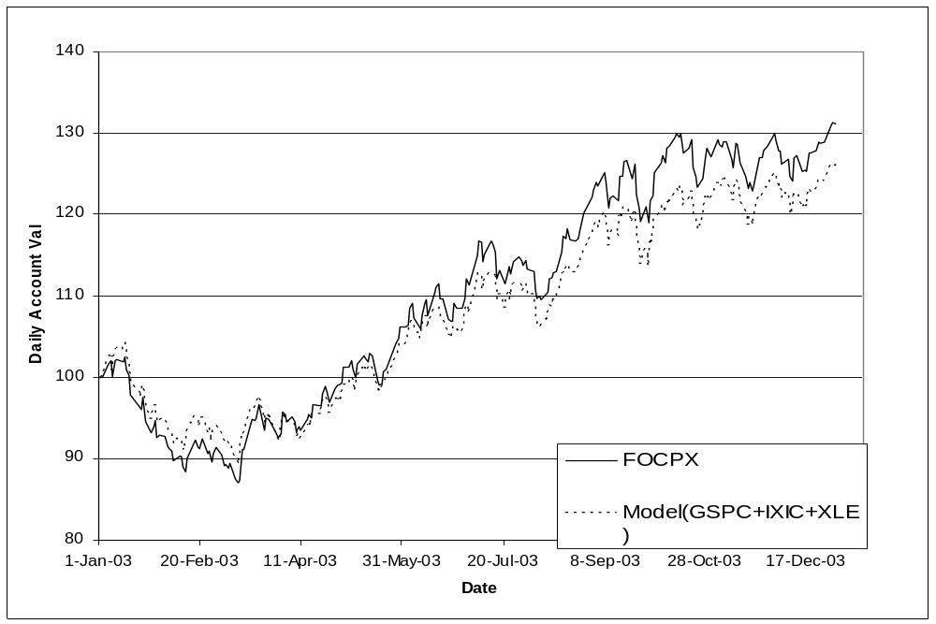
Results for Fidelity OTC Fund (GSPC+IXIC+XLE)
Daily closing prices for 2003: NAV vs synthetic model

Slide 33
Effect of Variable Selection
Different linear regression models for FOCPX:
Y =-0.035+0.897^IXIC
Y =-0.027+0.173^GSPC+0.771^IXIC
Y=-0.029+0.147^GSPC+0.784^IXIC+0.029XLE
Y=-0.026+0.226^GSPC+0.764^IXIC+0.032XLE-0.06^DJI
Have different prediction error (MSE):
MSE (IXIC) = 6.44%
MSE (GSPC + IXIC) = 5.95%
MSE (GSPC + IXIC + XLE) = 6.14%
MSE (GSPC + IXIC + XLE + DJIA) = 6.43%
Variable Selection is a form of complexity control
Good selection can be performed by domain experts

Slide 34
Discussion
Many funds simply mimic major indices
statistical NAV models can be used for ranking/evaluating mutual funds
Statistical models can be used for
- hedging risk and
- to overcome restrictions on trading (market timing) of domestic funds
80% of active fund managers under-perform their benchmarks → better use index funds

Slide 35
OUTLINE
Objectives
Methods’ taxonomy
Linear methods
Adaptive dictionary methods
- additive modeling and projection pursuit
- MLP networks
- Decision trees: CART and MARS
Kernel methods and local risk minimization
Empirical comparisons
Combining methods
Summary and discussion

Slide 36
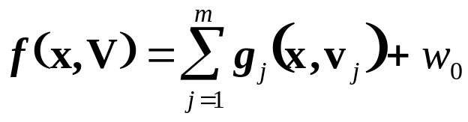
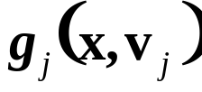


Additive Modeling & Projection Pursuit
Additive models have parameterization for regression
where is an adaptive basis function
Backfitting is a greedy optimization approach for estimating basis functions sequentially:
- basis function is estimated by holding all other basis functions fixed
Note: Backfitting + projection pursuit were covered in Lecture Set 5

Slide 37
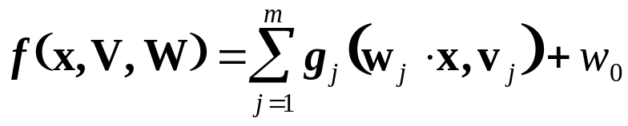


Projection Pursuit Regression
Projection Pursuit is an additive model:
where basis functions are univariate functions (of projections)
Backfitting algorithm is used to estimate iteratively
(a) basis functions (parameters ) via scatterplot smoothing
(b) projection parameters (via gradient descent)

Slide 38
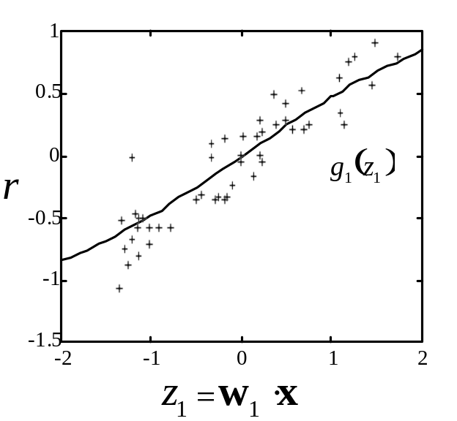
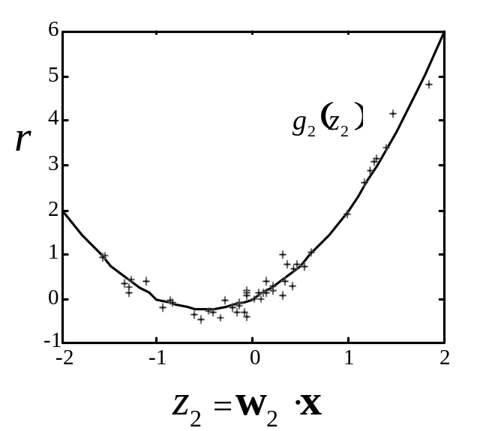

EXAMPLE: estimation of a two-dimensional fct via projection pursuit
Projections are found that minimize unexplained variance. Smoothing is performed to create adaptive basis functions.
The final model is a sum of two univariate adaptive basis functions.

Slide 39




Multilayer Perceptrons (MLP)
Recall MLP networks
for regression
where
or
Parameters (~ weights V and W) can be estimated via backpropagation algorithm

Slide 40



Backpropagation training
Minimization of
with respect to parameters (weights) W, V
Gradient descent optimization for
where
Careful application of gradient descent results
in backpropagation algorithm

Slide 41


Backpropagation: forward pass for training input x(k), estimate predicted output

Slide 42

Backpropagation: backward pass update the weights by propagating the error

Slide 43


Details of Backpropagation
Sigmoid activation - picture?
simple derivative
→ Poor behaviour for large t ~ saturation
How to avoid saturation?
- Proper initialization (small weights)
- Pre-scaling of inputs (zero mean, unit variance)
Learning rate schedule (initial, final)
Stopping rules, number of epochs
Number of hidden units (~basis functions)

Slide 44




Additional Enhancements
The problem: convergence may be very slow for error functional with different curvatures:
Solution: add momentum term to smooth oscillations
where and is momentum parameter

Slide 45
Comments on Gradient Descent Learning
Recall batch vs on-line learning
- Algorithmic approaches ~ batch
- Neural-network inspired methods ~ on-line
BUT the difference is only on the implementation level (so both types of learning should yield the same generalization performance)
Goal of training ~ ERM can be achieved using other optimization methods
Terminology: backpropagation, Deep Learning usually refer to both parameterization + optimization technique (gradient-descent)

Slide 46
Various forms of complexity control
MLP topology ~ number of hidden units
Constraints on parameters (weights) ~ weight decay
Type of optimization algorithm (many versions of backprop., other opt. methods)
Stopping rules
Initial conditions (initial ‘small’ weights)
Many factors make complexity control difficult; usually vary single complexity parameter while keeping all others fixed

Slide 47

Toy example: regression
Data set: 25 samples generated using sine-squared target function with Gaussian noise (st. deviation 0.1).
MLP network
(two hidden units)
→ underfitting

Slide 48

Toy example: regression
Data set: 25 samples generated using sine-squared target function with Gaussian noise (st. deviation 0.1).
MLP network
(10 hidden units)
→ near-optimal

Slide 49
Backpropagation for classification
Original MLP is for regression
(as introduced above)
For classification:
- use sigmoid output unit
- during training, use real-values 0/1 for class labels
- during operation, threshold the output of a trained MLP classifier at 0.5 to predict class labels

Slide 50

Toy example: classification
Data set: 250 samples ~ mixture of gaussians, where Class 0 data has centers (-0.3, 0.7) and (0.4, 0.7), and Class 1 data has centers (-0.7, 0.3) and (0.3, 0.3). The variance of all gaussians is 0.03.
MLP classifier
(two hidden units)

Slide 51

Toy example: classification
MLP classifier (six hidden units)
~ near optimal solution

Slide 52

MLP architectures
Supervised learning: single output
i.e., binary classification, regression
Supervised learning:
multiple outputs
Unsupervised learning (data compression)

Slide 53
NetTalk (Sejnowski and Rosenberg, 1987)
One of the first successful applications of backpropagation:
https://www.youtube.com/watch?v=gakJlr3GecE
Goal: Learning to read (English text) aloud, i.e.
Learning Mapping: English text → phonemes
Network inputs encode 7-letter window (the 4-th letter in the middle needs to be pronounced)
Network outputs encode phonemes (used in English)
The MLP network is trained using labeled data (both individual words and unrestricted text)

Slide 54

NetTalk architecture
Input encoding: 7x29 = 203 units
Output encoding: 26 units (phonemes)
Hidden layer: 80 hidden units

Slide 55
MLP networks: summary
MLP and Projection Pursuit models have the same mathematical parameterization but very different statistical properties:
MLP model ~ sum of many basis functions of projections (basis functions are the same)
PP model ~ sum of a few basis functions of projections (basis functions are adapted to data)
Model complexity control for MLP:
- may be tricky as it depends on many factors (optimization method, weight initialization, network topology)
- usually, tune just one factor (~others fixed) via resampling
- requires good engineering (~ intelligent tinkering)
NOTE: implementation of resampling may be tricky (with nonlinear optimization)

Slide 56



Regression Trees (CART)
Minimization of empirical risk (squared error) via partitioning of the input space into regions
Example of CART partitioning for a function of 2 inputs

Slide 57



Growing CART tree
Recursive partitioning for estimating regions (via binary splitting)
Initial Model ~ Region (the whole input domain) is divided into two regions and
A split is defined by one of the inputs(k) and split point s
Optimal values of (k, s) chosen so that splitting a region into two daughter regions minimizes empirical risk
Issues:
- efficient implementation (selection of optimal split)
- optimal tree size ~ model selection (complexity control)
Advantages and limitations

Slide 58



CART model selection
Model selection strategy
(1) Grow a large tree (subject to min leaf node size)
(2) Tree pruning by selectively merging tree nodes
The final model ~ minimizes penalized risk
where empirical risk ~ MSE
number of leaf nodes ~
regularization parameter ~
Note: larger → smaller trees
In practice: often user-defined (splitmin in Matlab)

Slide 59
Example: Boston Housing data set
Objective: to predict the value of homes in Boston
Data set ~ 506 samples total
Output: value of owner-occupied homes (in $1,000’s)
Inputs: 13 variables
1. CRIM per capita crime rate by town
2. ZN proportion of residential land zoned for lots over 25,000 sq.ft.
3. INDUS proportion of non-retail business acres per town
4. CHAS Charles River dummy variable (= 1 if tract bounds river; 0 otherwise)
5. NOX nitric oxides concentration (parts per 10 million)
6. RM average number of rooms per dwelling
7. AGE proportion of owner-occupied units built prior to 1940
8. DIS weighted distances to five Boston employment centres
9. RAD index of accessibility to radial highways
10. TAX full-value property-tax rate per $10,000
11. PTRATIO pupil-teacher ratio by town
12. B 1000(Bk - 0.63)^2 where Bk is the proportion of blacks by town
13. LSTAT % lower status of the population

Slide 60

Example CART trees for Boston Housing
1.Training set: 450 samples Splitmin =100 (user-defined)

Slide 61

Example CART trees for Boston Housing
2.Training set: 450 samples Splitmin =50 (user-defined)

Slide 62

Example CART trees for Boston Housing
3.Training set: 455 samples Splitmin =100 (user-defined) Note: CART model is sensitive to training samples (vs model 1)

Slide 63
Decision Trees: summary
Advantages
- speed
- interpretability
- different types of input variables
Limitations: sensitivity to
- correlated inputs
- affine transformations (of input variables)
- general instability of trees
Variations: ID3 (in machine learning), linear CART

Slide 64
MARS
MARS features and improvements (over CART)
- continuous approximation (via tensor-product splines)
- greedy selection of low-order basis functions
- variable selection (local + global)
MARS complexity control
- lack of fit measure based on Generalized Cross Validation (GCV), i.e. MSE on the training set penalized by model complexity (tree size)
MARS applicability
- good for modeling additive functions
- good for high- and low-dimensional problems with a small number of low-order interactions (local or global)
Interaction occurs when the effect of one variable (on the output) depends on the level of other variable

Slide 65



MARS Basis Functions
Truncated Splines
a pair of truncated linear splines
Basic building block

Slide 66


Tensor-Product Splines
Multivariate Splines
Tensor product
adaptive selection of knot locations
Valid knot locations

Slide 67


MARS Tree Structure
Each node ~ active basis function
Basis functions estimated recursively (greedy opt.)
On each path, variables are split at most once
Depth of tree indicates interaction level

Slide 68




Algorithm for MARS
Forward stepwise: search over each node to find
- split variable
- split point t
- coefficients (weights of basis functions)
that minimize the lack of fit criterion (GCV)
Backwards stepwise: remove nodes which cause
- decrease of gcv or
- the smallest increase of gcv
GCV criterion
where and (suggested value)

Slide 69
MARS Summary
Advantages
Provides variable subset selection
Continuous approximation
Works well for low-order interactions and additive functions
Interpretable
Limitations
- sensitive to coordinate rotation
- problems in dealing with collinear variables
- stability of MARS modeling for small samples

Slide 70
OUTLINE
Objectives
Methods taxonomy
Linear methods
Adaptive dictionary methods
Kernel methods and local risk minimization
- kernel methods and local risk minimization
- Generalized Memory-Based Learning
- Constrained Topological Mapping
Empirical comparisons
Combining methods
Summary and discussion

Slide 71





Local Risk Minimization (LRM)
Local learning (memory-based learning):
estimate a function at a single point x0
Local risk minimization
local neighborhood function
normalizing function
The goal is minimization of local prediction risk over a set of and over the kernel width using only training data

Slide 72
Practical Implementation of LRM
Sumultaneous minimization of local risk over and over kernel width is hard
Practical methods assume fixed (constant or linear) parameterization and then adjust only the kernel width.
Local Estimation at a point x0 :
Select approximating functions of fixed low complexity, and select kernel function (i.e. gaussian or hard threshold).
Select optimal kernel width, providing minimum of estimated local risk. That is, selectively decrease training sample (near x0 ) to make an estimate.

Slide 73



LRM and Kernel Methods
Consider minimization of Local Empirical Risk
assuming constant parameterization
→ local average
(similarly, for local linear parameterization)
Hence, solution to LRM (with fixed kernel width) leads to kernel methods, such as k-nearest neighbors regression.

Slide 74



Practical Selection of Kernel Width
Global Adaptive Approach: the kernel width is estimated globally, independent of a particular estimation point.
Global model selection for k-nn regression:
For a given value of k :
Compute a local estimate at each input
Compute total empirical risk of these estimates
Estimate prediction risk using (analytic) model selection criterion.
Minimize this risk through appropriate selection of k.

Slide 75


Generalized Memory-Based Learning
For a given new input, an output is estimated via local learning using past data
GMBL implements locally weighted linear approximation minimizing
where the kernel
has adaptable width and scale parameters estimated via cross-validation using all data

Slide 76

Constrained Topological Mapping
Recall applying SOM
to regression problem
Nonadaptive
CTM Approach:
Given training data (x,y) perform
Dimensionality reduction x→z
(Apply SOM to x-values of training data)
2. Apply kernel regression to estimate y=f(z) at discrete points in z-space

Slide 77



Adaptive CTM Implementation
Batch implementation
Local linear modeling for each CTM unit
Variable selection via adaptive scaling
where
Final neighborhood width (model complexity) selected via cross-validation

Slide 78
OUTLINE
Objectives
Methods taxonomy
Linear methods
Adaptive dictionary methods
Kernel methods and local risk minimization
Empirical comparisons
Combining methods
Summary and discussion

Slide 79
Empirical Comparisons
Challenge of comparisons
- who performs comparisons (experts vs general users)
- goals of comparison
- synthetic vs real-life data set comparisons
Importance of experimental procedure
- clear specs for training/validation/test data
- provisions for model selection
- assumptions about training and test data

Slide 80
Application of Adaptive Methods
Choose flexible method (parameterization)
Choose complexity parameter
- automatic (from data) or user-selected
Estimate model (from training data)
Estimate prediction performance(on test data)
NOTE: empirical comparison (of methods) is difficult because prediction performance depends on all factors (1) - (3), in addition to data itself

Slide 81
Comparison Study
Cherkassky et al. (1996), Comparison of adaptive methods for function estimation, IEEE Trans. on Neural Networks
Objectives and assumptions
- non-expert users
- public-domain s/w for regression methods
- manual model selection using test set; just a few user-defined parameters
- off-line training (batch mode)
Goal of comparisons
- methods’ parameterization and
- model selection for synthetic data sets

Slide 82
Objectives and assumptions (cont’d)
Methods in XTAL package
k- nearest neighbors regression (k-NN)
Linear Regression (LR)
Projection Pursuit (PPR)
Multivariate Adaptive Regression Splines (MARS)
Generalized Memory-Based Learning (GMBL)
Constrained Topological Mapping (CTM)
Artificial Neural Network / backpropagation (ANN)
Synthetic data
- low- and high-dimensional
- uniformly distributed in x-space

Slide 83
Experimental Set-Up
Specification of
properties of synthetic data: target functions, training/test set size, x-distribution, noise level
performance metric: NRMS error (for test set)
4 parameter settings for each method:
KNN: k = 2, 4, 8, 16
GMBL: no parameters (run only once)
CTM: smoothing parameter = 0, 2, 5, 9
MARS: smoothing parameter = 0, 2, 5, 9
PPR: number of terms (in the smallest model) = 1, 2, 5, 8
ANN: number of hidden units = 5, 10, 20, 40

Slide 84


Training Data
- uniform distribution (random and spiral)
- size: smalle (25), medium (100), large (400)
- noise level: none, medium(SNR=4), large (SNR=2)
Test data: 961 samples (no noise)
- spaced uniformly on 2D grid (for 2-dimensional data)
- randomly sampled for high-dimensional data

Slide 85




2D Target functions
Function 1 | Function 2
Function 3 | Function 4

Slide 86




2D Target functions (cont’d)
Function 5 | Function 6
Function 7 | Function 8

Slide 87
Comparison Summary
BEST WORST
Prediction accuracy (dense samples) ANN KNN, GMBL
Prediction accuracy (sparse samples) GMBL, KNN MARS, PP
Additive target functions MARS, PP KNN, GMBL
Harmonic functions CTM, ANN PP
Radial functions ANN, PP KNN
Robustness wrt parameter tuning ANN, GMBL PP
Robustness wrt sample properties ANN, GMBL PP, MARS
Methods performance
- similar at dense (large) samples
- uneven at sparse samples and depends significantly on the properties of data sets

Slide 88
Comments on Specific Methods
Comparison metrics:
(a) generalization
(b) robustness wrt parameter tuning
(c) robustness to data characteristics
kNN and GMBL:
(a) inferior to other methods when accurate prediction is possible
(b) very robust
(c) very robust

Slide 89
Comments on Specific Methods (cont’d)
MARS
(a) good for additive functions
(b) somewhat brittle
(c) rather unpredictable
PPR
(a) good for additive functions, functions of linear combinations of inputs; poor for harmonic functions
(b) brittle
(c) rather unpredictable

Slide 90
Comments on Specific Methods (cont’d)
ANN
(a) good for functions of linear combinations, harmonic and radial-type functions
(b) very robust
(c) very predictable
CTM
(a) very good for harmonic functions, poor functions of linear combinations
(b) robust
(c)predictable; best for spiral distribution in x-space

Slide 91
Conclusions
Comparison results are always biased by
- selection of data sets
- s/w implementation of adaptive methods
- (expert) user bias
Relative performance varies with properties of data sets (i.e. sample size, noise level etc)
Heuristic optimization methods (ANN, CTM) are computationally intensive but often more robust than faster statistical methods
Nonlinear methods should be robust: only for robust methods it is possible to develop automatic parameter tuning (complexity control)

Slide 92
OUTLINE
Objectives
Methods taxonomy
Linear methods
Adaptive dictionary methods
Kernel methods and local risk minimization
Empirical comparisons
Combining methods
Summary and discussion

Slide 93
Motivation for Combining Methods
General setting (used in this course)
- given training data set
- apply different learning methods
- select the best model (method)
Learning Method + Data → Predictive Model
Why discard other models?

Slide 94
Motivation (cont’d)
Learning Method + Data → Predictive Model
Theoretical and empirical evidence
- no single ‘best’ method exists
Always possible to find:
- best method for given data set
- best data set for given method
Philosophical + statistical connections, Eastern philosophy, Bayesian averaging:
Combine several theories (models) explaining the data

Slide 95
Strategies for Combining Methods
Predictive model depends on 3 factors
(a) parameterization of admissible models
(b) random training sample
(c) empirical loss (for risk minimization)
Three strategies (for improved generalization)
1. Different (a), the same (b) and (c)
→ Committee of Networks, Stacking, Bayesian averaging
2. Different (b), the same (a) and (c)
→ Bagging
3. Different (c), the same (a) and (b)
→ Boosting

Slide 96

Combining Strategy 1
Apply N different methods (parameterizations) to the same data → N distinct models
Form (linear) combination of N models

Slide 97
Combining Strategy 1 (cont’d)
Design issues:
What parameterizations (methods) to use?
- as different as possible
How many component models?
How to combine component models?
- via empirical risk minimization (neural network strategy)
- Bayesian averaging (statistical strategy)

Slide 98







Committee of networks approach
Given training data
Estimate N candidate (regression) models
using different methods
Construct the combined model as
where coefficients are estimated via min. of emp. risk
under
constraints

Slide 99




Example of Committee Approach
Regression data set:
with x-values uniform in [0,1] and noise variance
Regression methods used
(a) polynomial
(b) trigonometric
(c) combined (Committee of Networks)
Model selection:
- VC model selection for (a) and (b)
- empirical risk minimization for (c)

Slide 100

Comparison: 25 training samples
Red ~ target function; Blue dashed ~ polynomial model
Blue dotted ~ trigonometric model; Black ~ combined model

Slide 101

Comparison: 50 training samples
Red ~ target function; Blue dashed ~ polynomial model
Blue dotted ~ trigonometric model; Black ~ combined model

Slide 102
Comparison results
25 training samples: Model f(x) MSE(f(x),target) Poly (d=3) 0.0857
Trigon (d=3) 0.0237
Combined 0.0239
(alpha=0.5)
50 training samples: Model f(x) MSE(f(x),target) Poly (d=4) 0.0046
Trigon (d=4) 0.0044
Combined 0.0038
(alpha=0.2)

Slide 103
Stacking approach
Given training data
Estimate N candidate (regression) models
using different methods
Construct the combined model as
where coefficients are estimated via resampling
under
constraints

Slide 104

Empirical Comparison
The same data set and experimental setup
Committee approach ~ Comb 1 Stacking approach ~ Comb 2

Slide 105
Summary and Discussion
Linear (nonadaptive) methods for regression
- theoretically well-understood
- effective methods for complexity control
Nonlinear (adaptive) methods
- inherently complex (non-tractable optimization)
- difficult to apply analytic model selection and resampling
- no single best method exists for all data sets
Combining methods often yield better prediction
Another direction: complexity control via loss fct.

